Slide 1
elephant
An
Never forgets

Slide 2
Technologies
Java Beans
Java Collections
JSON
Socket IO
Testing
(JUNIT)
UML
Hibernate
Modern Software Designs
Model
View
Controller
Android HTTP
Android UI
Parallel Processing
THE PLAN:
Sandbox “play”
Think
Design
Create Tests
Create Solution
“Old habits die hard…”
Notes:
Temptation to jump from “Play” → Solution
It now makes sense why you diagram.

Slide 3
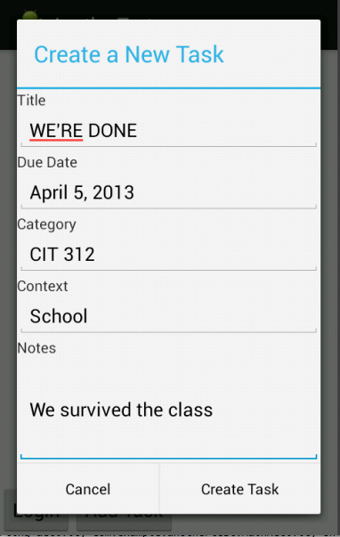
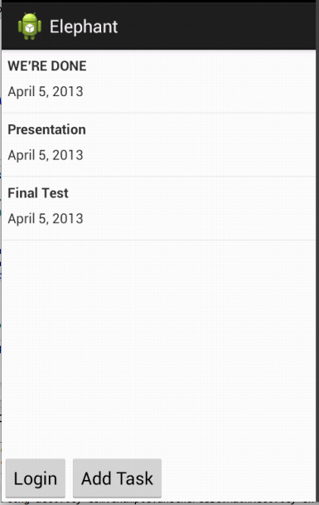
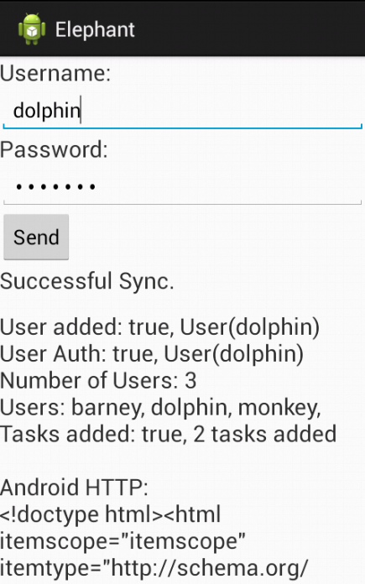
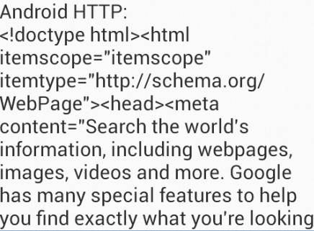
Create Task
TaskList
Login-Sync

Slide 4
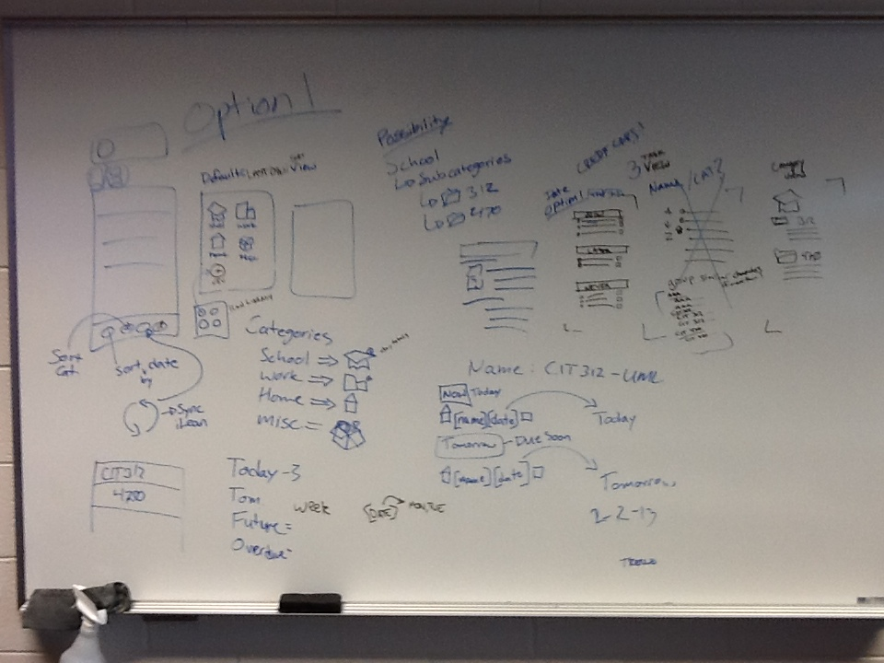
Notes:
Oh Crap Diagramming before we discussed the UI (too many assumptions) – Team Communication
Users hate buttons, lists, forms, hidden objects.
Our app is essentially all of the this!
Big challenge.

Slide 5
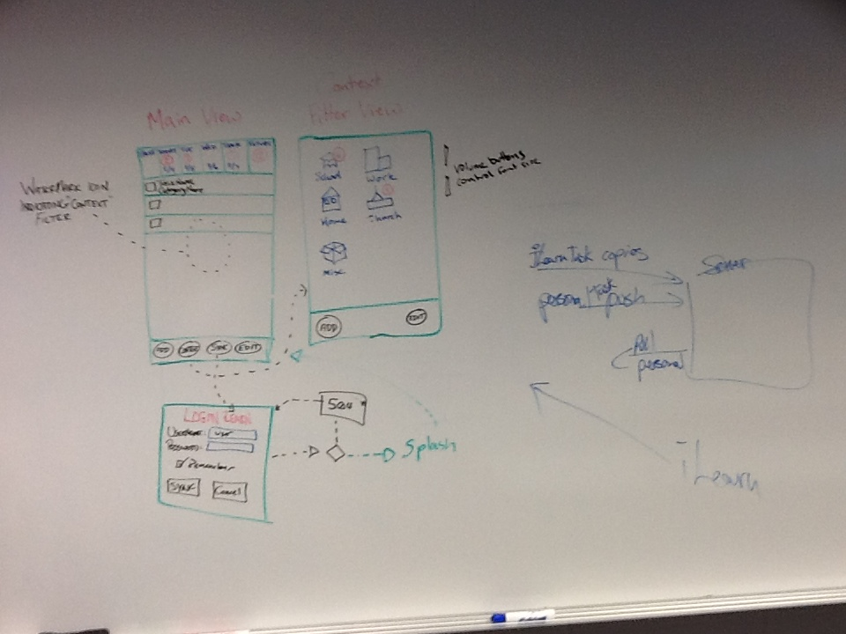
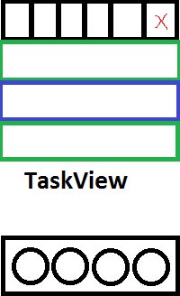
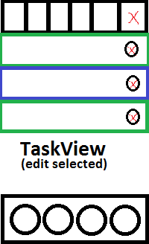
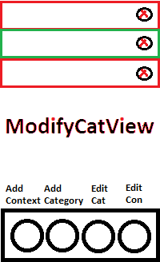
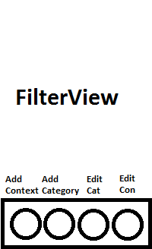
Notes:
Simplified the UI – Unified our Approach

Slide 6
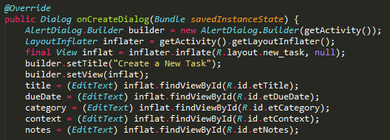
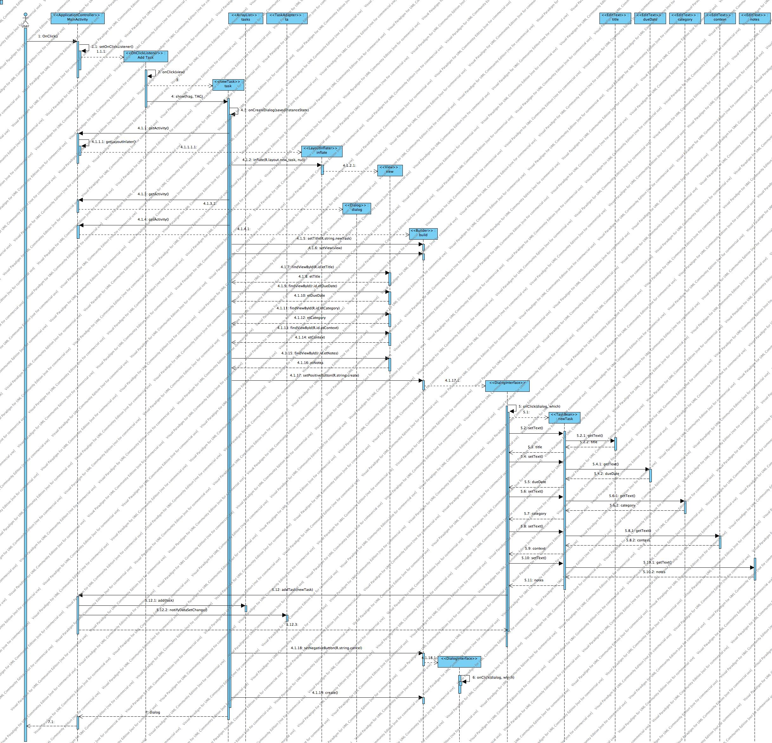
Android UI
Notes:
Activities → Fragments
The power of diagramming!

Slide 7
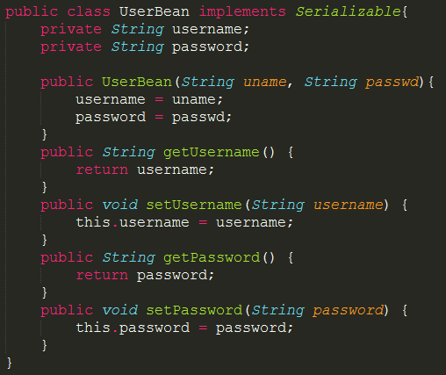
Java Beans
They serialize nicely
Good for encapsulating data
Can be stored, restored
Notes:
JavaBeans streamlines the transfer of data.
Works great with Hibernate!

Slide 8
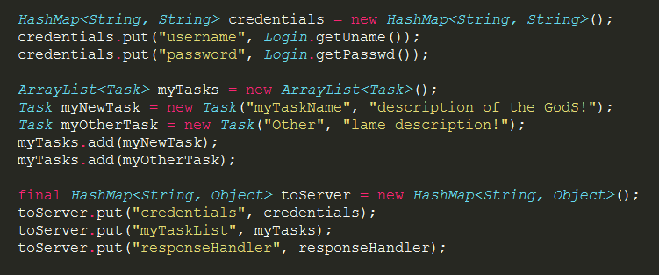
Java Collections
Set
HashSet
LinkedHashSet
TreeSet
List
ArrayList
Vector
LinkedList
Map
Hashtable
LinkedHashMap
HashMap
TreeMap
Notes:
ArrayLists are faster for accessing, more versatile.
There are other options that would be better suited for maintaining sorted lists → Did not consider this until we thought about another use-case, brings increased value to diagramming everything before the creating the solution.
HashMaps are faster at inserting and getting of elements.

Slide 9
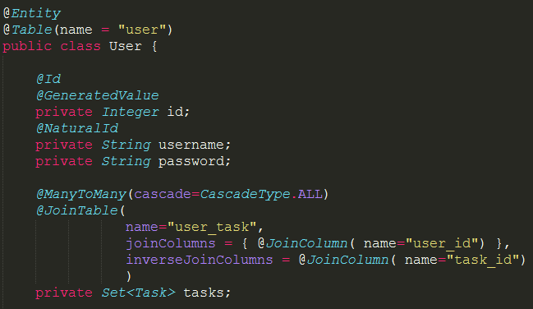
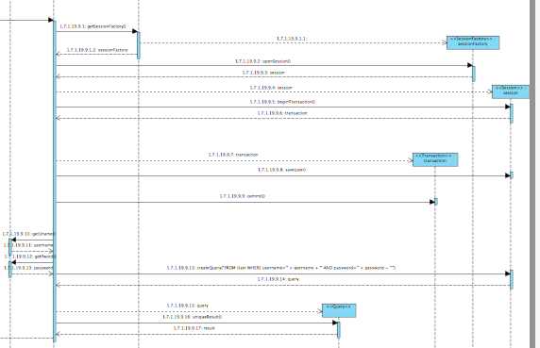
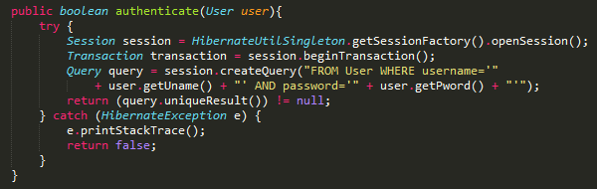
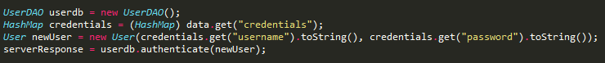
Hibernate
Notes:
At first, HashMap of handlers to compartmentalized DAO
Modularity – DAO objects to interact with the db
Next level – ideally list of actions sent to DAO for 1 session

Slide 10
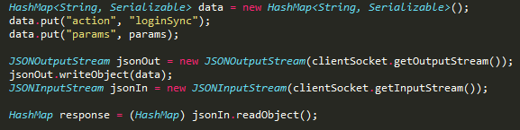
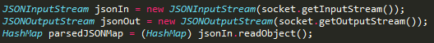
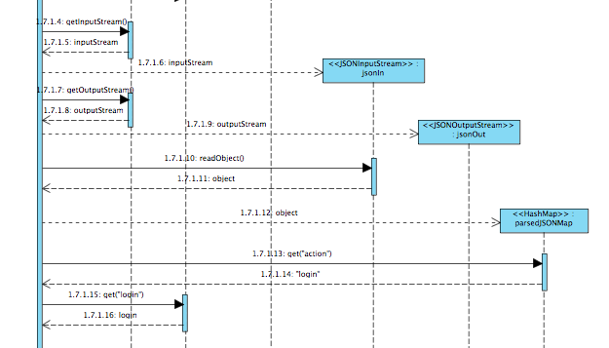
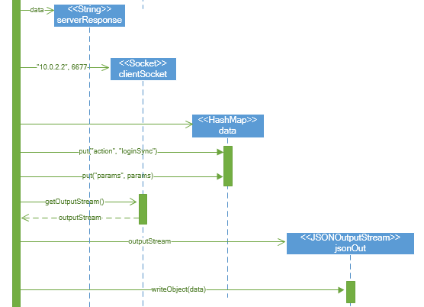
JSON Data Serialization
Android-Client
Server
Notes:
Universal data-transfer language.
Send over a single HashMap (serializable) that contains everything..
What’s awesome about libraries, you don’t have to reinvent the wheel.

Slide 11
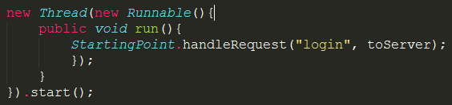
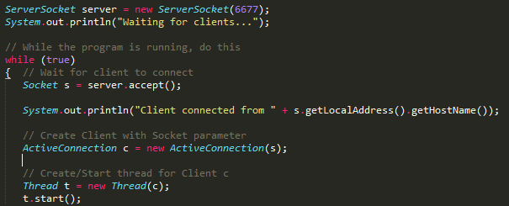
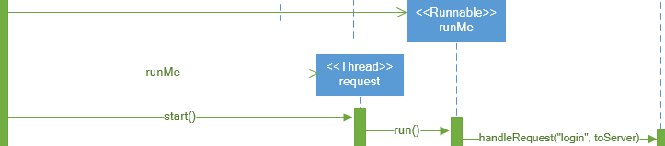
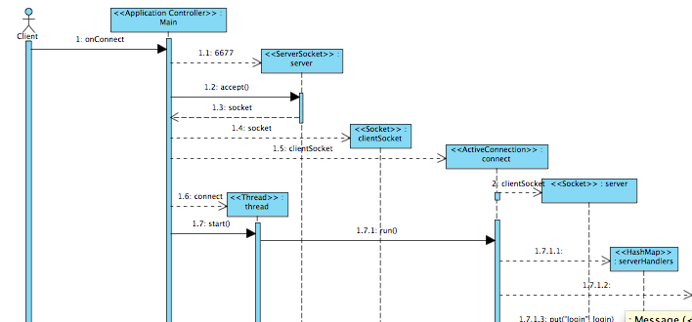
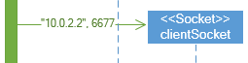
Socket IO, Parallel Processing
Android-Client
Server
Notes:
Can’t be run in main thread… Had to create a runnable.
Choices – Threads vs Executors
Threads – Directly control thread creation/management, instantiate our own Threads individually
Executors – to abstract thread management from the rest of the app, pass tasks to an executor.
One drawback is that you have to explicitly shutdown() and awaitTermination() before you exit your application - which is not so easy in GUI apps.
Seemed natural to use Threads in the Android Application, extended same behavior to server as well; although use of executors would be ideal for a server (thread pools, fork/join).
Threads are not always required, only required you want it as a background process or concurrency.

Slide 12
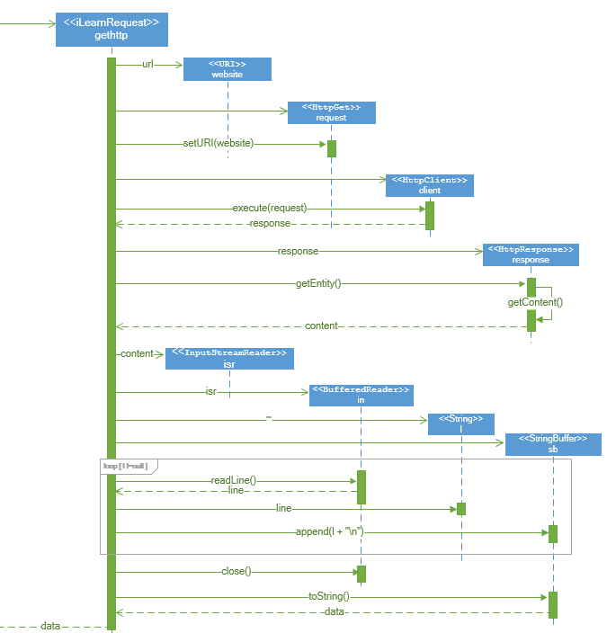
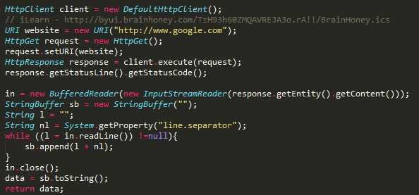
Android HTTP
Notes:
Pretty much like wget or curl – same functionality
iLearn - Get data from server with help of HTTP request and response.

Slide 13
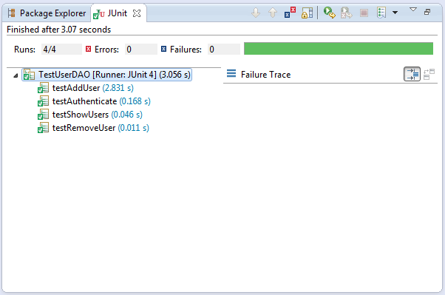
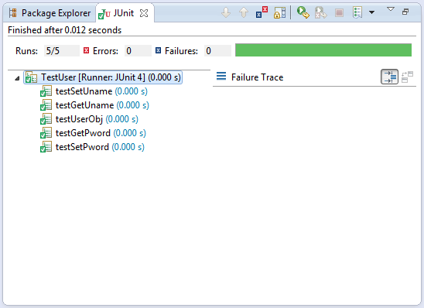
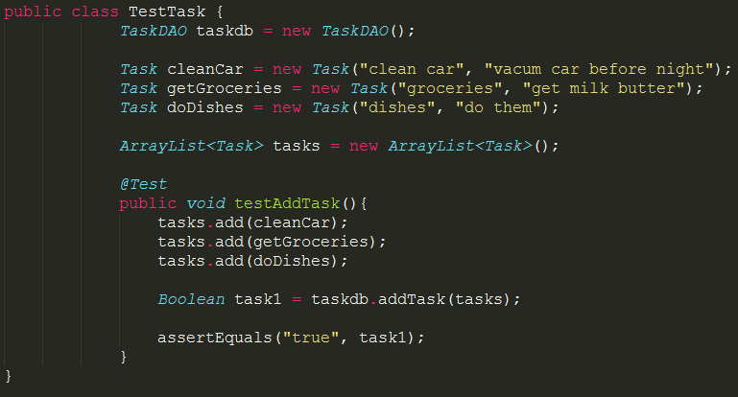
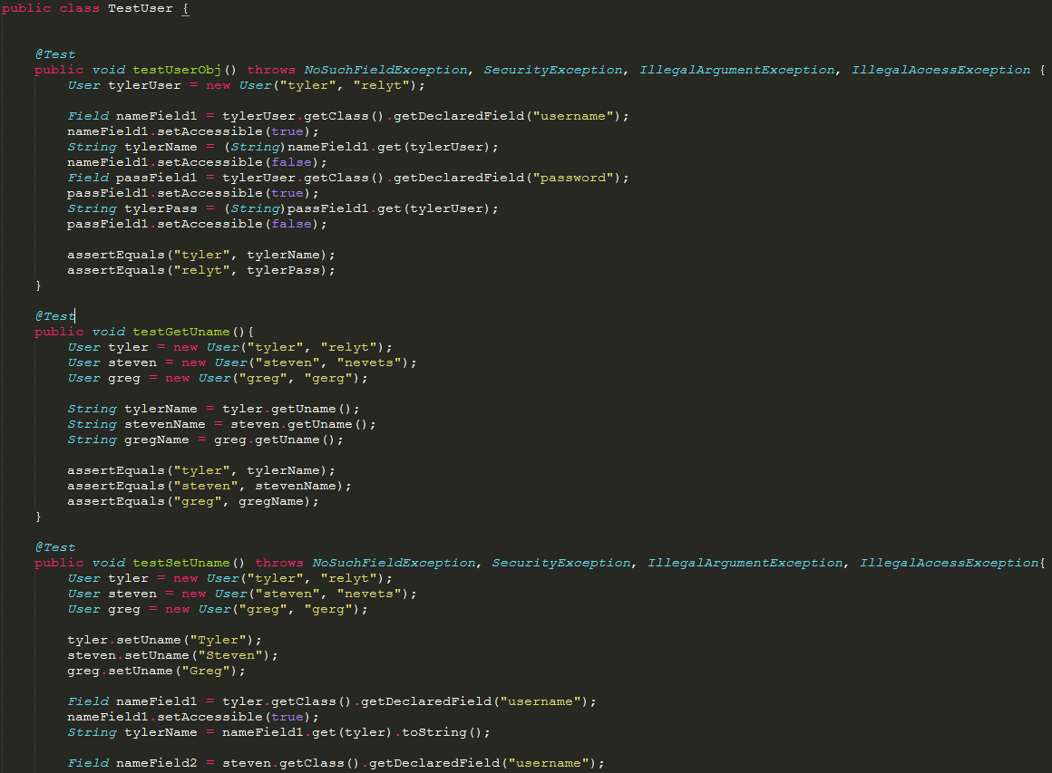
JUNIT Tests
Task, Hibernate, Server
User
Notes:
Wasted time coming up with my own “tests”
Great value in creating tests before creating the solution
Know what to expect, outlines purpose for the methods.
JUNIT cannot do Android tests.

Slide 14
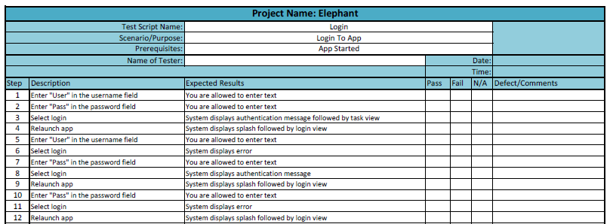
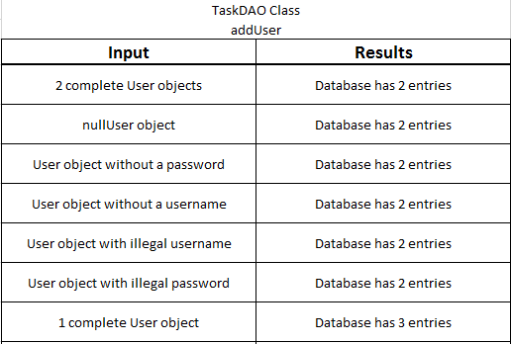
Other Tests
Test Script
Text Matrix
Notes:
Helps design functionality, outlines what is expected.

Slide 15



We are but apprentices to the master.
Notes:
Master, Journeyman, Apprentice Concept.
Takes time to cultivate understanding/knowledge.
Team Collaboration – stress when not unified in purpose → outline path
Brining Individual Strengths to the Team.
Evaluate the credibility of internet resources → Learning how to ask the right questions. (Not just to Barney, but even Google)
Cultivate the skill in finding information.
Try, Try, Again – keep track of what you’ve done (git branches)

Slide 16
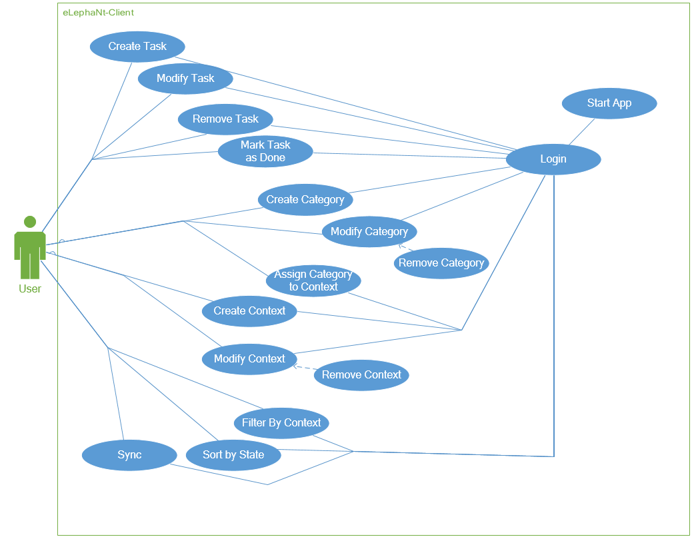
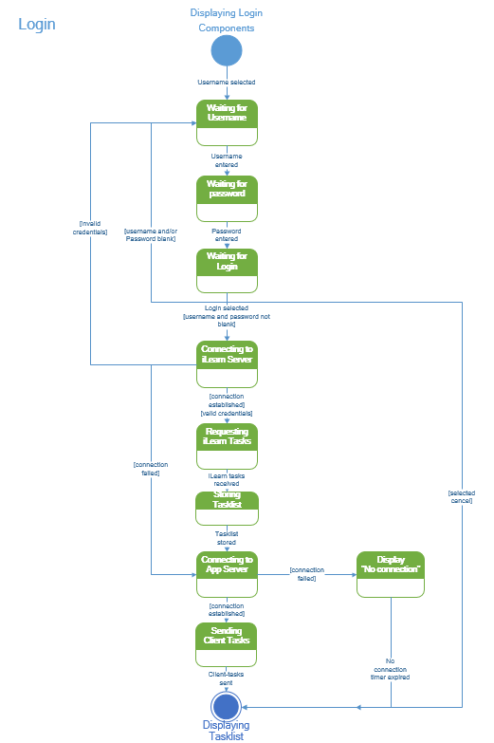
Use-Case Diagram
State Diagram

Slide 17
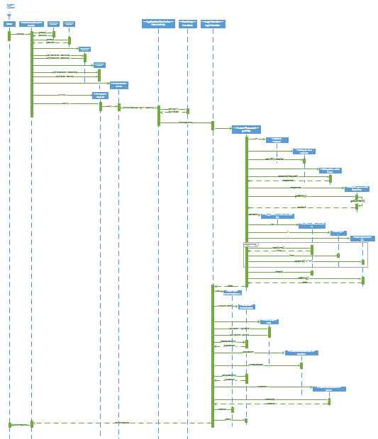
Client-Sequence Login

Slide 18
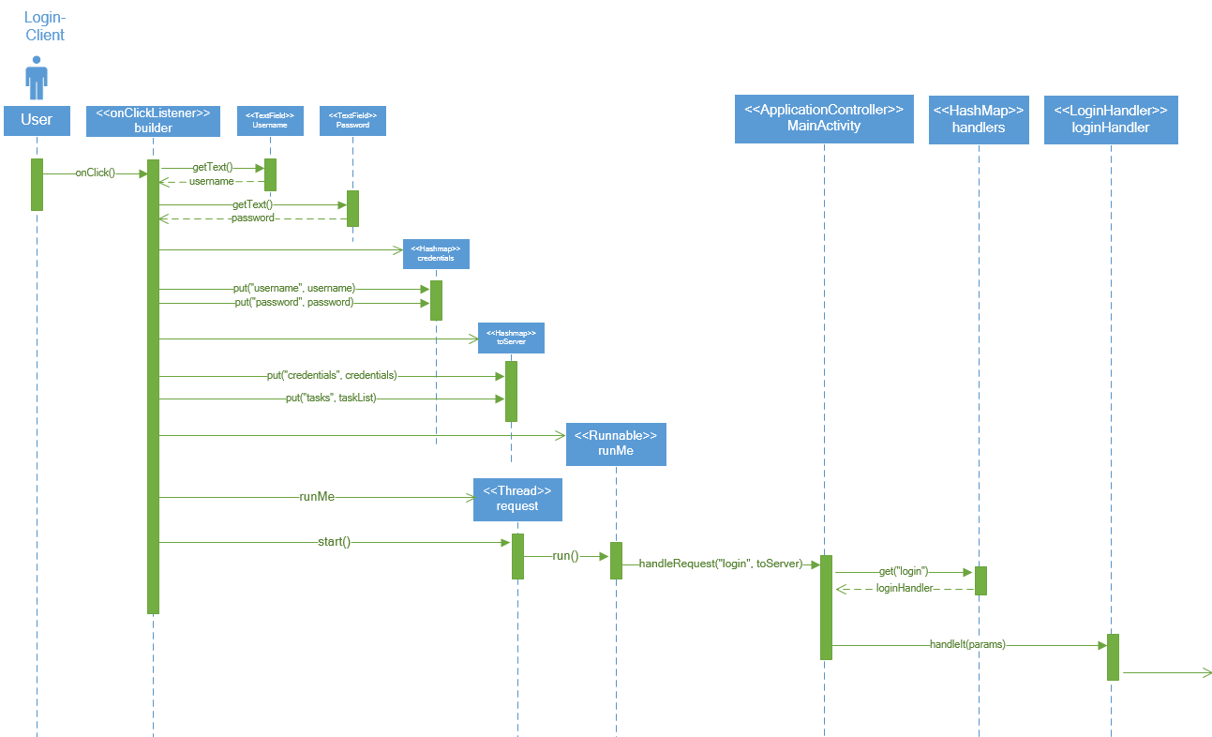
Client-Sequence: Part One
Java Collections, Java Beans, Android UI, Parallel Processing, Modern Software Design, MVC Software Design Pattern

Slide 19
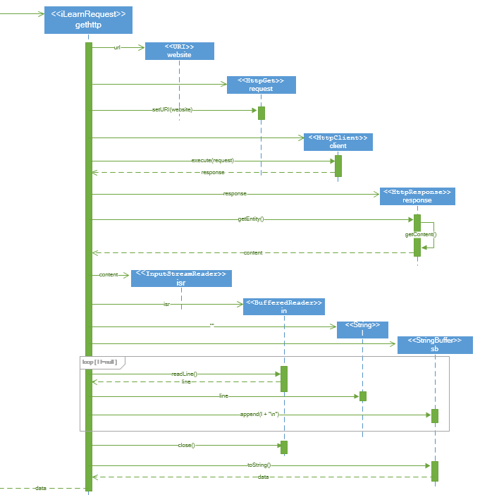
Client-Sequence Part Two: iLearnRequest
Android HTTP Communication

Slide 20
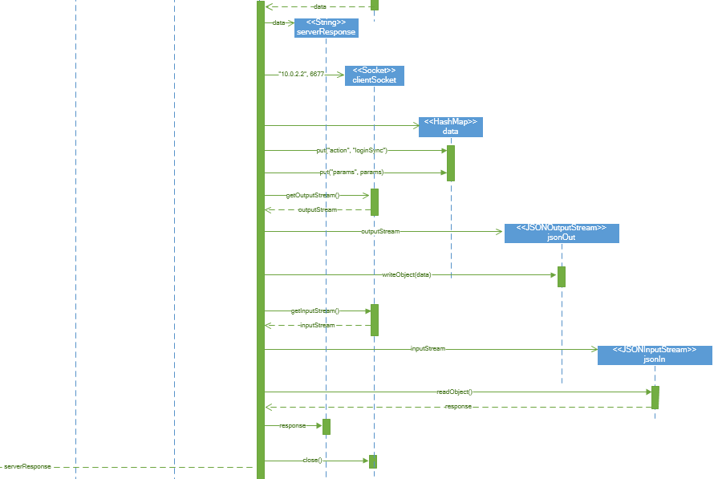
Client-Sequence Part Three:
Socket IO,
JSON data serialization

Slide 21
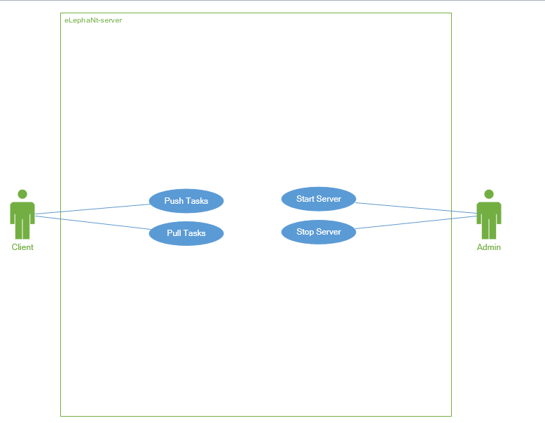
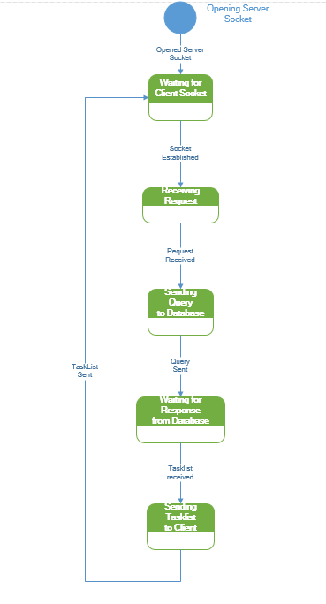
Use-Case Diagram
State Diagram

Slide 22
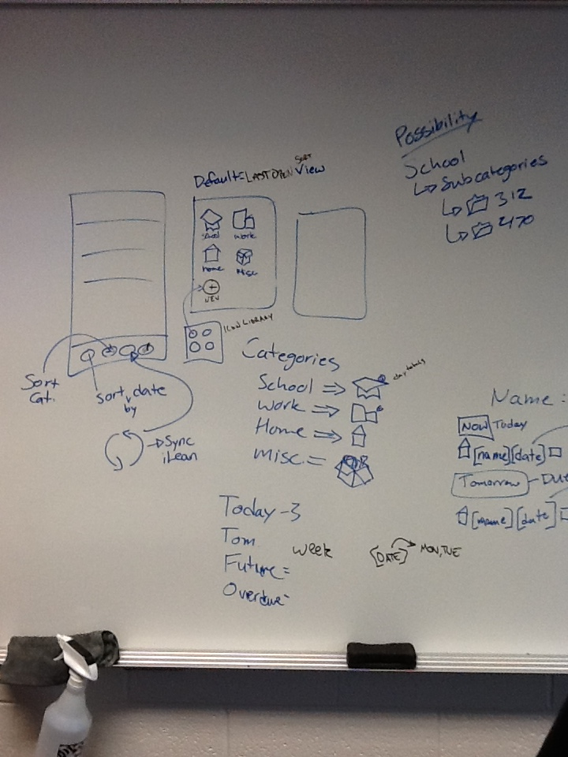

Slide 23
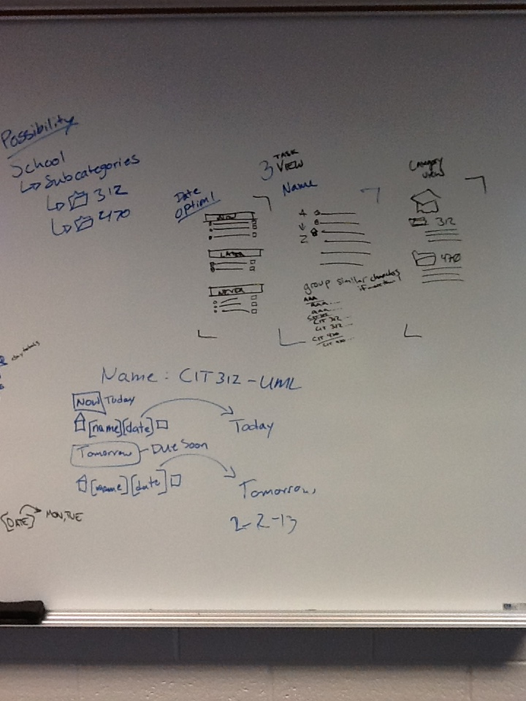

Slide 25
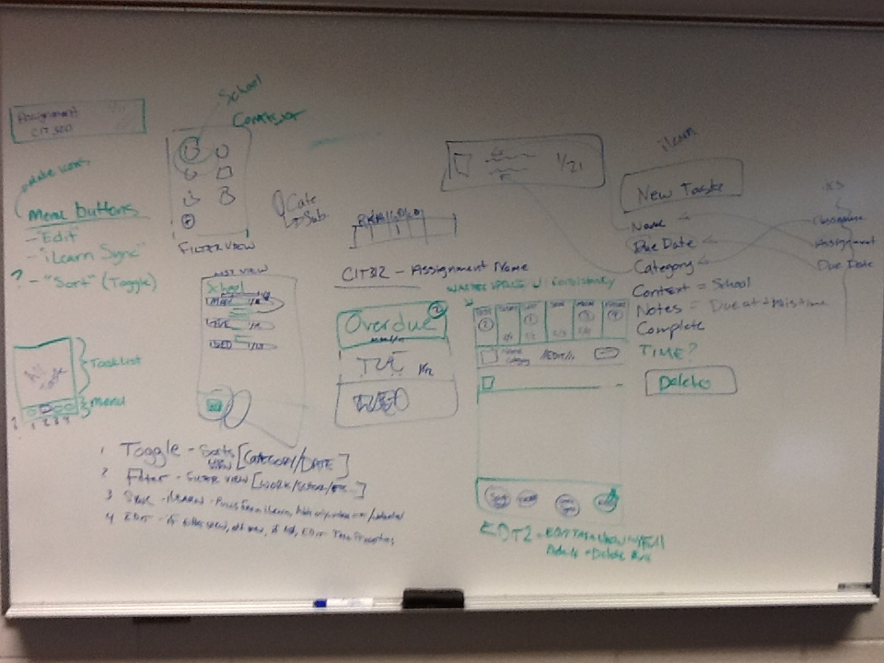

Slide 27
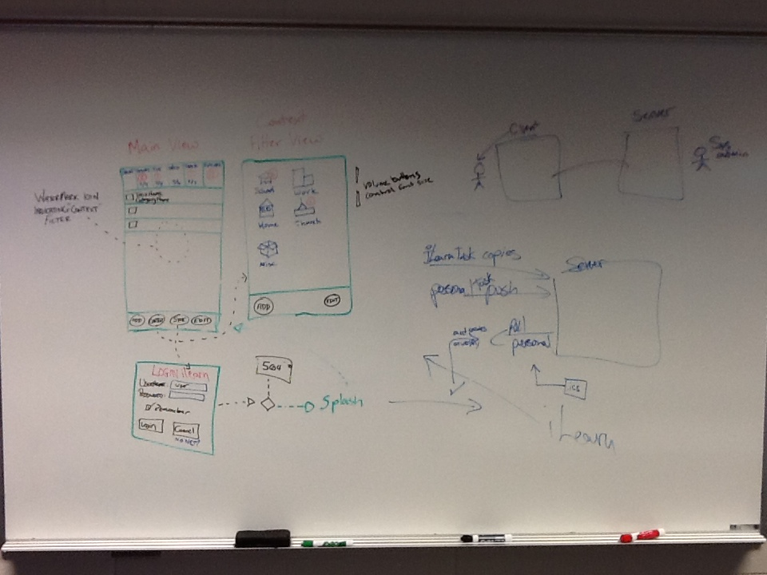

Slide 28
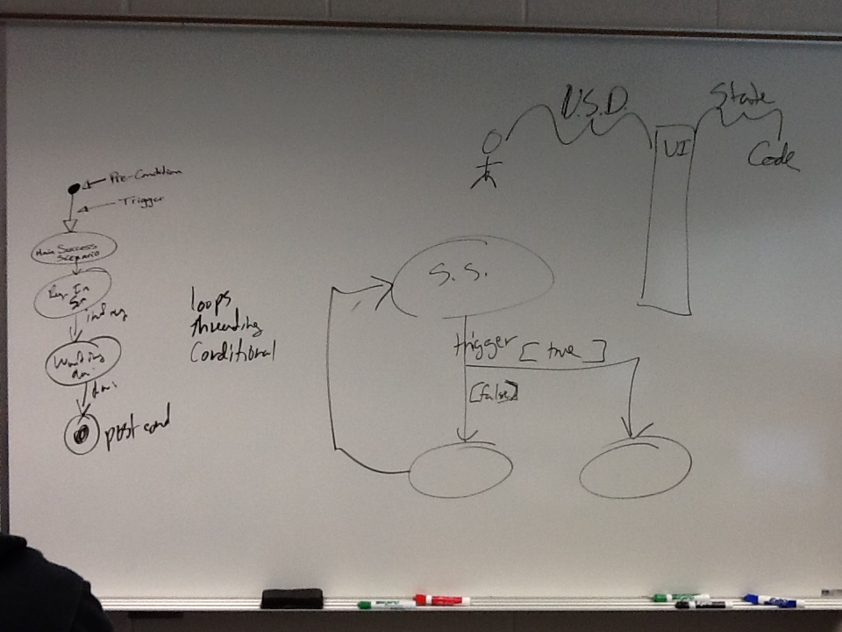

Slide 29
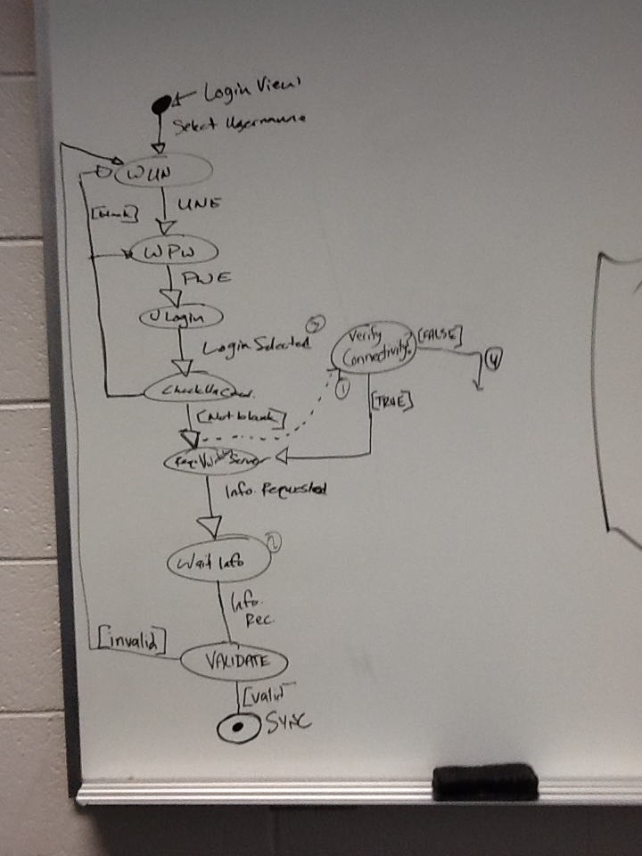

Slide 30
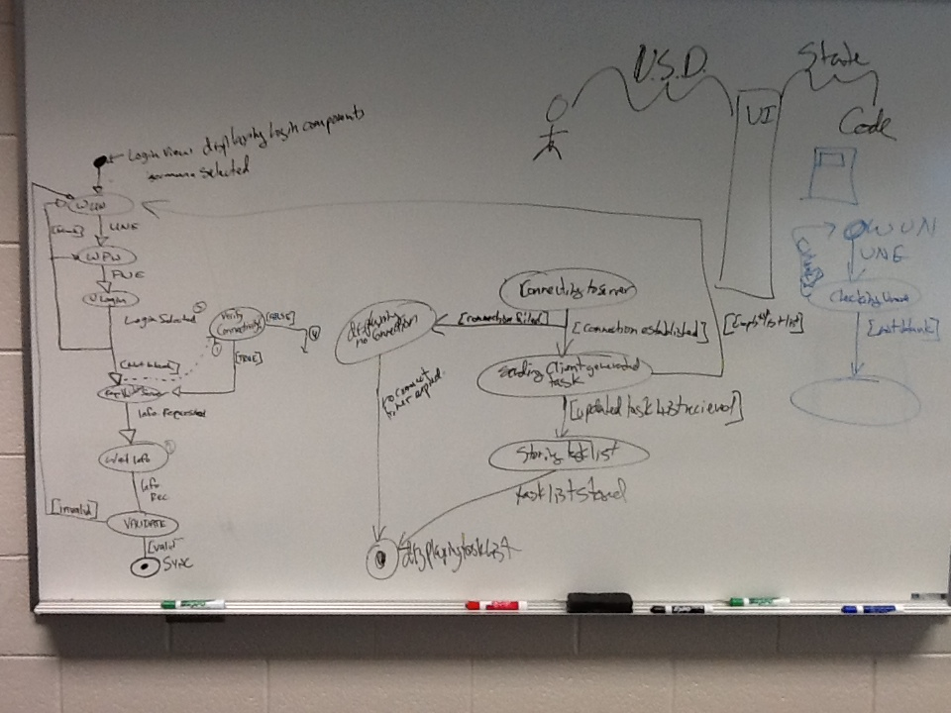

Slide 31


Slide 32


Slide 33


Slide 34


